Slide 1

Course Id :INT 213

Slide 2

SELECTION STATEMENT

Slide 3
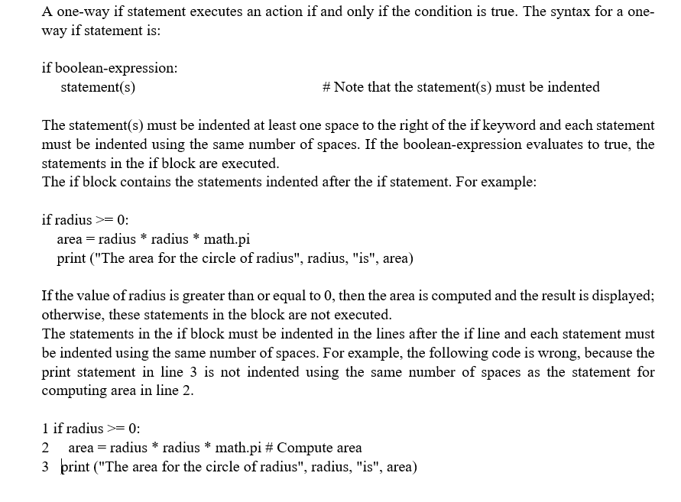
IF STATEMENT

Slide 4
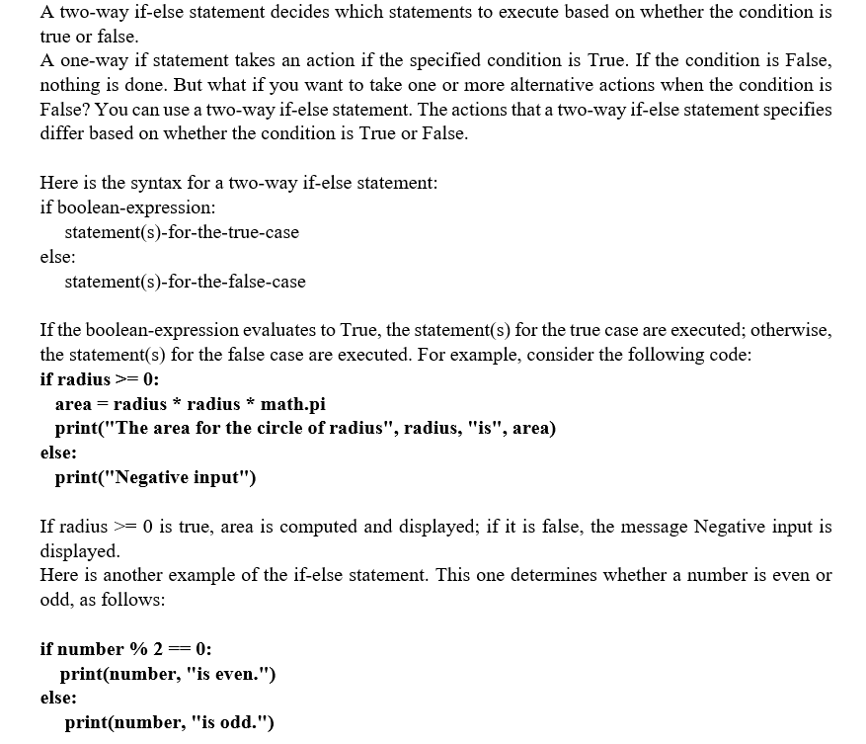
IF-Else

Slide 5
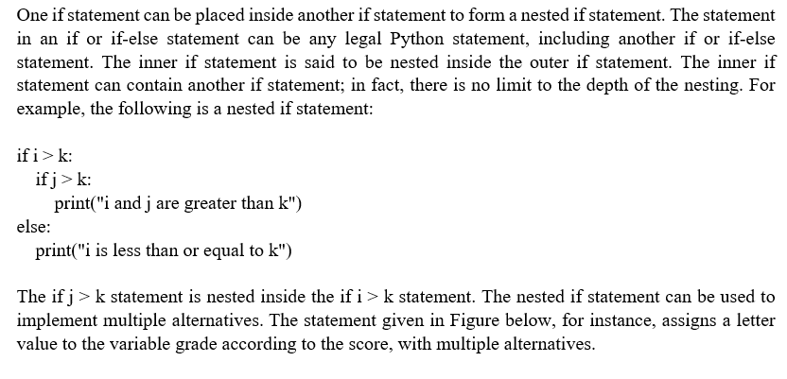
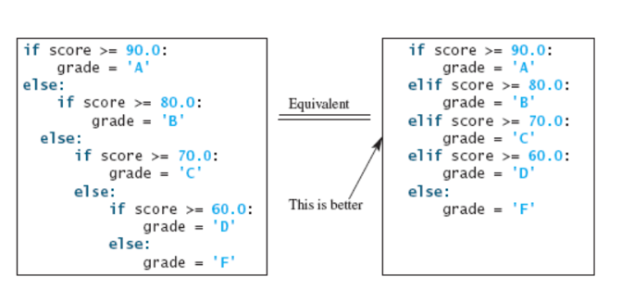
NESTED IF AND IF-ELIF-ELSE

Slide 6
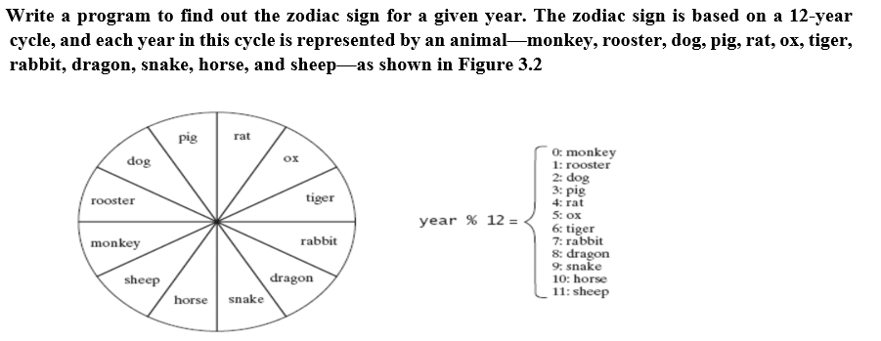
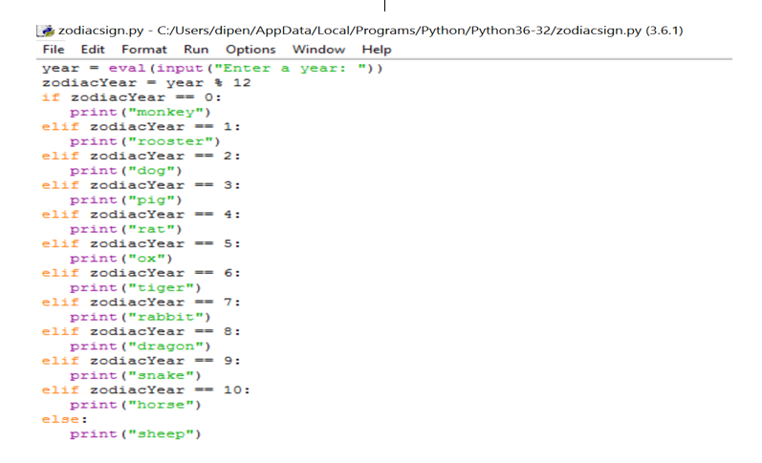
PROGRAM

